Slide 1
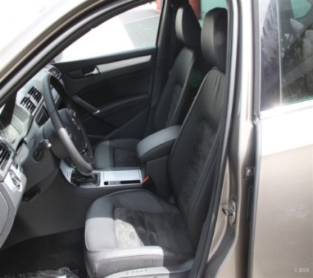

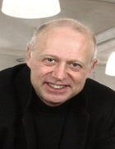


We helped a leading automotive seat supplier to develop and pilot end to end customer-oriented innovation process
Automotive & Assembly (AI) | Asia-Pacific
A&A027
Situation
What we did
Impact
A leading supplier of automotive seat in Asia with a strong market share at ~40%
The industry pricing is facing pressure because OEMs are dominant in defining both product design and pricing
The Asian consumers’ needs have evolved and been voiced over on internet with the rapid development of digital in Asia
Generate car seat specific customer insights via digital listening and focus group discussion
Establish a consumer-oriented innovation system that includes a 360 degree consumer insight development system and cross-functional ideation process
Develop a coherent and replicable co-development process with OEM through leveraging customer-oriented innovation and pilot with selected OEMs
Leveraged customer insights to
prioritize 20+ existing innovations to be consumer oriented
drive new innovation into future product development
Achieved potential sales of high margin car seat to auto OEMs through innovation roadshows
M&S Expertise
Sha Sha
Nick Arnold
Arthur Wang
Vivian Lu

